Slide 1
Recursion
7.0

Slide 2
Main concepts to be covered
Recursive methods.
Recursive classes.
Recursive data structures.

Slide 3
Recursion
Recursion is a powerful programming feature.
It allows things to be repeated.
It is an alternative to using a loop to repeat actions.
Functional programming languages use recursion exclusively to repeat actions – they don't have loops.

Slide 4
Recursion
Recursion exists when something is defined by reference to itself:
A method that calls itself.
A class defined in terms of itself.
We will look at both of these ideas.

Slide 5
A recursive method
public void sayHello()
{
System.out.println("Hello!");
sayHello();
}
The sayHello method calls itself – infinitely.
Expected output:
Hello!
Hello!
Hello!
Hello!
Hello!
…

Slide 6
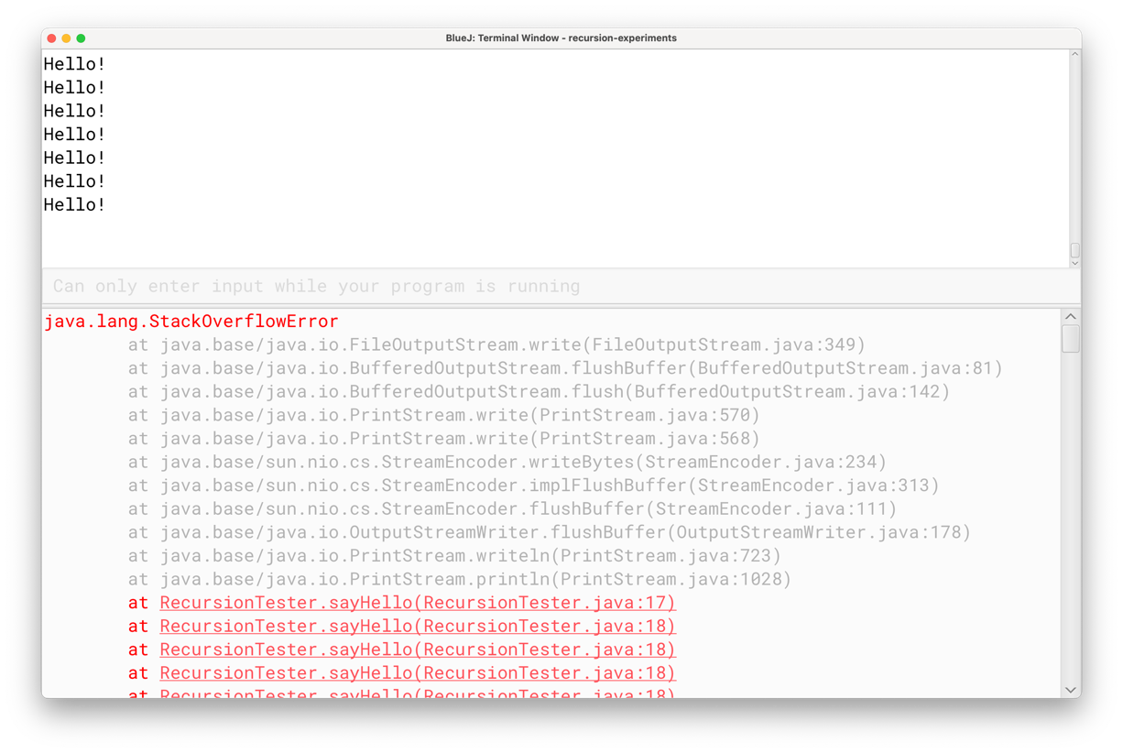
A recursive method
Infinite recursion leads to a runtime failure: StackOverflowError
Actual output

Slide 7
Infinite recursion
Each time the sayHello method is called (recursively) more runtime memory is used.
The total amount of memory is limited.
Eventually, there is no more left and there is no room for (yet) another recursive call.
The manifestation is a StackOverflowError.
That doesn't happen with an equivalent 'forever' loop version because repeating a loop does not require more memory.

Slide 8
Avoiding infinite recursion
To avoid infinite recursion, there needs to be a route through a recursive method that does not involve a recursive call.
This is called a 'base case'.
A base case provides an escape from infinite recursion.
A base case could be 'empty'; i.e., involve no action, but that still has the effect of limiting the recursion.

Slide 9
Avoiding infinite recursion
A base case often results from the use of an if-statement.
This example limits the number of times "Hello!" is printed.
public void sayHello(int numberOfTimes)
{
if(numberOfTimes > 0) {
System.out.println("Hello!");
sayHello(numberOfTimes - 1);
}
}

Slide 10
Avoiding infinite recursion
The if condition will either make another recursive call …
… or choose a non-recursive base case.
In this case, the base case does nothing, but ends the recursion.
So, there is a non-recursive route through the method.
public void sayHello(int numberOfTimes)
{
if(numberOfTimes > 0) {
System.out.println("Hello!");
sayHello(numberOfTimes - 1);
}
}

Slide 11
The recursive calls

Slide 12
The Divide and Conquer Technique

Slide 13
Divide and Conquer
'Divide and conquer' is a problem-solving technique that often involves recursion.
A complex problem is broken down into smaller, less complex problems.
Breaking down the problem often involves recursive steps.
The lowest-level problems are the base cases.
The sub-problems are often independent.
It might be possible to solve them concurrently for faster runtime.

Slide 14
Divide and Conquer: binary search
Searching an unsorted list is relatively slow.
On average, half the list will have to be searched.
The whole list must be searched if the value is not present.
If the list is sorted, then the search time can be reduced considerably.
Check against the item in the middle of the list.
If it is the one being looked for then the search is over.
If not, then the middle one is either smaller or larger.
If it is larger, just check the items to the left of the middle one.
If it is smaller, check the items to the right of the middle one.

Slide 15
Divide and Conquer: binary search
At each step, we eliminate half of the remaining items.
This considerably reduces the search time.
At each step, we (recursively) apply the previous technique by starting in the middle of whichever half is left.

Slide 16
Binary search of sorted data
Find the index of value in nums.
public static int search(int[] nums, int value)
{
// Search tnums[0] to nums[nums.length – 1].
return binarySearch(nums, value, 0, nums.length);
}
First index of the search range (inclusive)
Last index of the search range (exclusive)

Slide 17
Binary search of sorted data
private static int binarySearch(int[] nums, int value, int first, int last)
{
if(first >= last)
return -1;
else {
int middle = (last + first) / 2;
if(value == nums[middle])
return middle;
else if(value < nums[middle])
return binarySearch(nums, value, first, middle);
else
return binarySearch(nums, value, middle + 1, last);
}
}
Match
Recursive calls with reduced ranges.

Slide 18
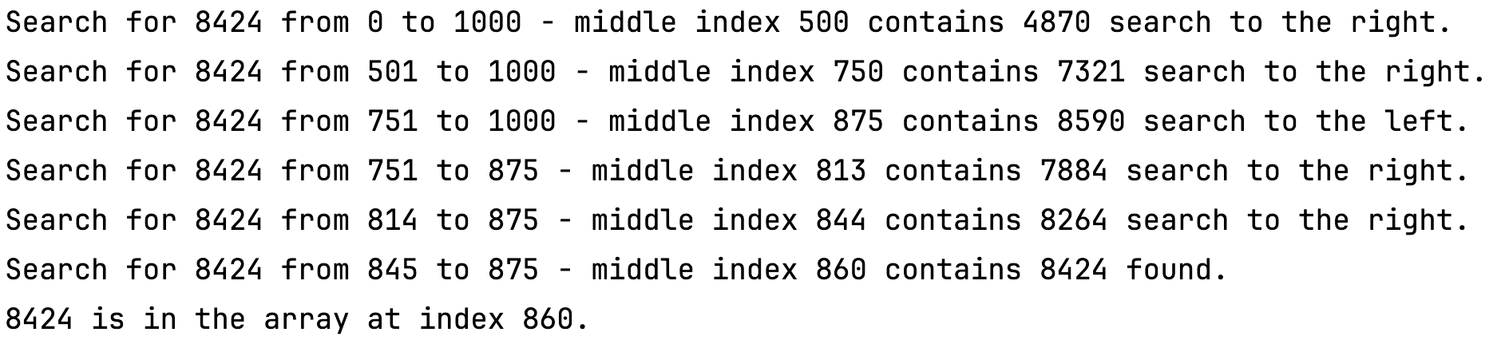
Divide and Conquer: binary search
Search for the value 8424 in a sorted array of 1000 integers.

Slide 19
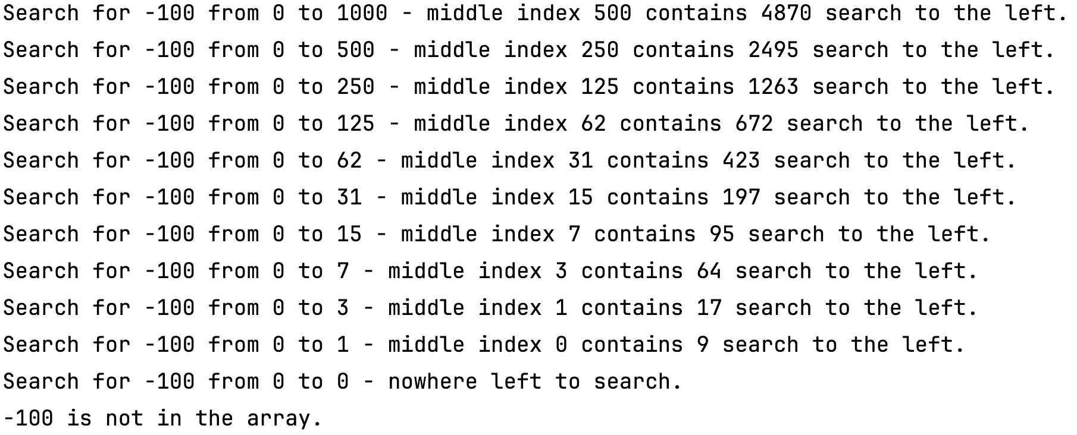
Divide and Conquer: binary search
Search for the value -100 in a sorted array of 1000 integers.

Slide 20
Recursion in Class Definitions

Slide 21
Recursive classes
The fields of a class may be defined recursively.
This means that a class is defined with fields of that class type.
The Room class is defined recursively.
A Room object contains other Room objects – that is how rooms are connected.
public class Room
{
// The room's name.
private final String name;
// The room's description.
private final String description;
// Exits to connected rooms.
private final HashMap<String, Room> exits;

Slide 22
Recursive data types
Recursive class definitions are common in implementing 'recursive data types':
Linked list.
Queue.
Tree.
Graph.
Recursive data structures commonly have methods that are recursive.
Recursive methods are often easier to write for their functionality.
For example, inserting data into a tree.

Slide 23
Recursion seen in a computer file system

Slide 24
The file-system project
A computer file system is a recursive data structure.
A folder (aka 'directory') contains:
Ordinary files: Word documents, images, spreadsheets, source files, etc.
Folders - which contain ordinary files and folders (which contain …)
The recursion stops when either a folder is empty, or it only contains ordinary files.
This is called a 'tree structure'.
The 'root' is at the top.
The 'leaves' are at the bottom: files and empty folders.

Slide 25
A Computer File System
Tasks we might want to perform on a file system:
Find all files of a particular type; e.g., music files.
Find very large files so that they can be removed to free-up space.
Find empty files.
Find empty folders.
Find the amount of space occupied by the files in a folder.

Slide 26
A Computer File System
We often want to perform these tasks on a folder and all of its subfolders, and all of those subfolders, etc.
These tasks can all be expressed recursively.
It is typically easier to code recursively than iteratively the operations applied to recursive data structures.

Slide 27
Recursively List Folders
public void listFolder(File folder)
{
for(File file : folder.listFiles()) {
System.out.println(file.getName());
if(file.isDirectory()) {
listFolder(file);
}
}
}
Recursive call for sub-folders.

Slide 28
Recursion for route finding

Slide 29
Route Finding: recursive classes and methods
Recall that the Room class is defined recursively.
Suppose we want to find a route within a network of rooms.

Slide 30
Route finding
Find a route from 'this' room to the given destination.
First check the neighbors.
public String findRoute(String destination)
{
String route = null;
Iterator<Entry<String, Room>> it = exits.entrySet().iterator();
while(it.hasNext() && route == null) {
Entry<String, Room> pair = it.next();
if(pair.getValue().getName().equals(destination))
route = pair.getKey();
}
if(route != null)
return route;

Slide 31
Route finding
Ask the neighbors if 'this' is not directly connected.
if(route != null)
return route;
else {
it = exits.entrySet().iterator();
while(it.hasNext() && route == null) {
Entry<String, Room> pair = it.next();
route = pair.getValue().findRoute(destination);
if(route != null)
route = pair.getKey() + " " + route;
}
return route;
}
Recursive call to neighbors.

Slide 32
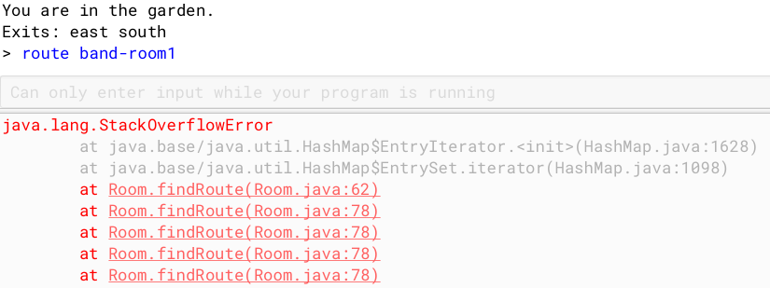
Route finding
garden.findRoute("band-room1");

Slide 33
Route finding
'garden' asks its neighbour 'kitchen' to find a route.
'kitchen' doesn't have 'band-room1' as a direct neighbour.
So, it asks its neighbour 'garden'.
'garden' asks 'kitchen' …
… endlessly.
We need a way to avoid revisiting a room that's already been tried.

Slide 34
private String findRoute(String destination, Set<Room> visited)
{
visited.add(this);
String route = null;
Iterator<Entry<String, Room>> it = exits.entrySet().iterator();
while(it.hasNext() && route == null) {
Entry<String, Room> pair = it.next();
Room neighbor = pair.getValue();
if(! visited.contains(neighbor)) {
if(neighbor.getName().equals(destination))
route = pair.getKey();
else {
route = neighbor.findRoute(destination, visited);
if(route != null)
route = pair.getKey() + " " + route;
}
}
}
return route;
}
Keep track of 'visited' rooms.

Slide 35

Route finding
garden.findRoute("band-room1");
Note: This finds a route but does not guarantee to find the shortest route.
A shorter route is: south south up west.

Slide 36
Review
Recursion is a powerful programming feature.
Recursion exists when something is defined by reference to itself:
A method that calls itself.
A class defined in terms of itself.

Slide 37
Review
Recursion allows actions to be repeated.
It is an alternative to using a loop to repeat actions.
Recursion often works well with recursive data structures, such as graphs and trees.

Slide 38
Review
Care must be taken to avoid 'infinite recursion'.
Infinite recursion is avoided by having one or more non-recursive 'base cases' within the logic of a recursive method.
It is also avoided by avoiding repeating previous, identical actions.

